Slide 1

Phishing Awareness Training
By Munizah Ali

Slide 2
TABLE OF CONTENT
Importance of this Training
What is Phishing?
Major Objectives
Types Of Phishing Attacks
Examples Of Phishing Attacks
Ways to Protect Yourself From Phishing Attacks

Slide 3
IMPORTANCE OF THIS TRAINING
Phishing awareness training is important because it helps people recognize and avoid fake emails, messages, or websites that steal sensitive information like passwords, credit card details, or personal data. Cybercriminals often use tricks to make their scams look real, and anyone can fall for them without proper knowledge. This training teaches employees or individuals how to spot suspicious activities, handle them safely, and protect themselves and their organization from potential threats. It’s a simple but powerful way to prevent data breaches, financial losses, and security risks.

Slide 4

What Is PHISHING
Phishing is a type of online scam where cybercriminals trick people into revealing sensitive information like passwords, credit card numbers, or personal details. They often do this by sending fake emails, and messages, or creating fake websites that look like legitimate ones. The goal is to deceive the victim into clicking on malicious links, downloading harmful files, or sharing confidential information.

Slide 5
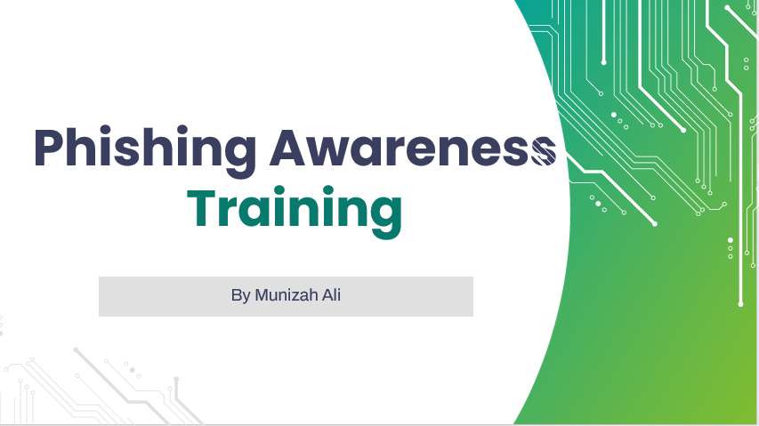
MAJOR OBJECTIVE
The major objective of phishing awareness training is to equip individuals with the knowledge and skills to recognize and respond to phishing attempts, reducing the risk of data breaches, financial losses, and security threats for themselves and their organization.

Slide 6
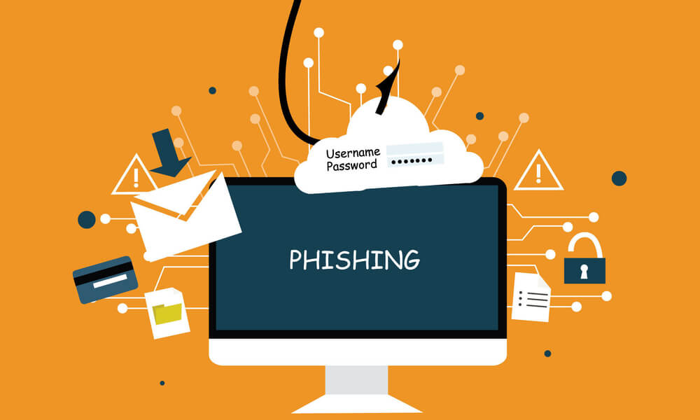
TYPES OF PHISHING ATTACKS
EMAIL PHISHING
MAN IN THE MIDDLE ATTACKS
SPEAR PHISHING
ANGLER PHISHING
CLONE PHISHING
WHALING
SOCIAL ENGINEERING
VOICE PHISHING
LINK MANIPULATION

Slide 7
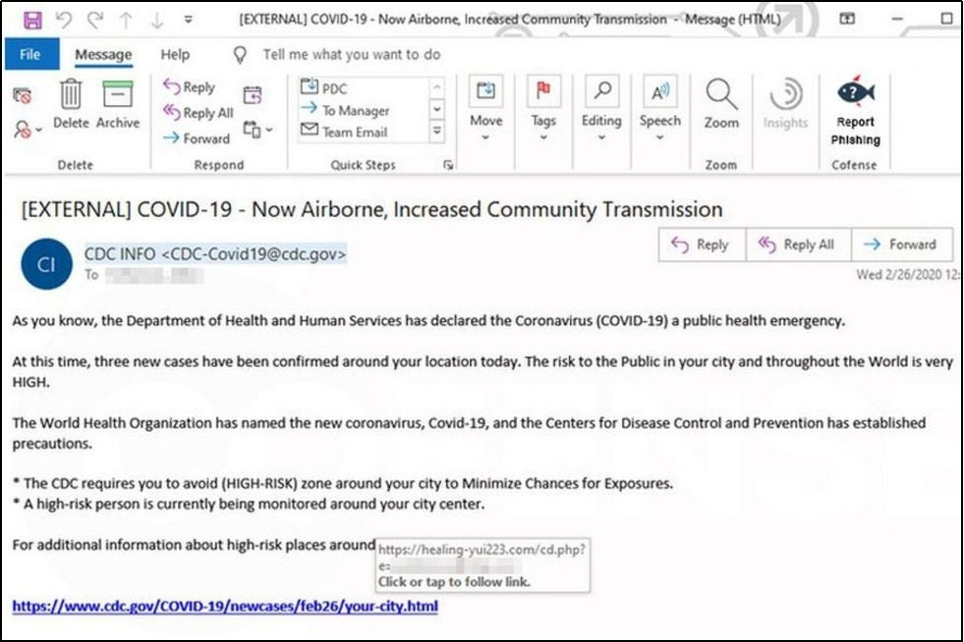
EXAMPLES OF PHISHING ATTACKS

Slide 8
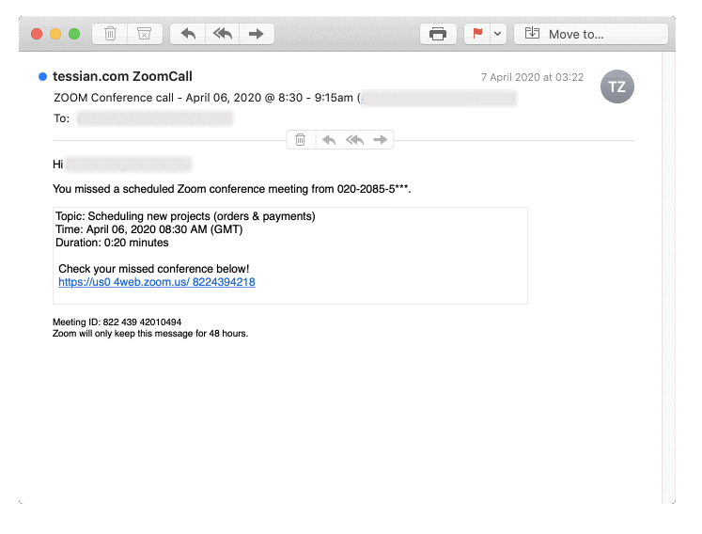
EXAMPLES OF PHISHING ATTACKS

Slide 9
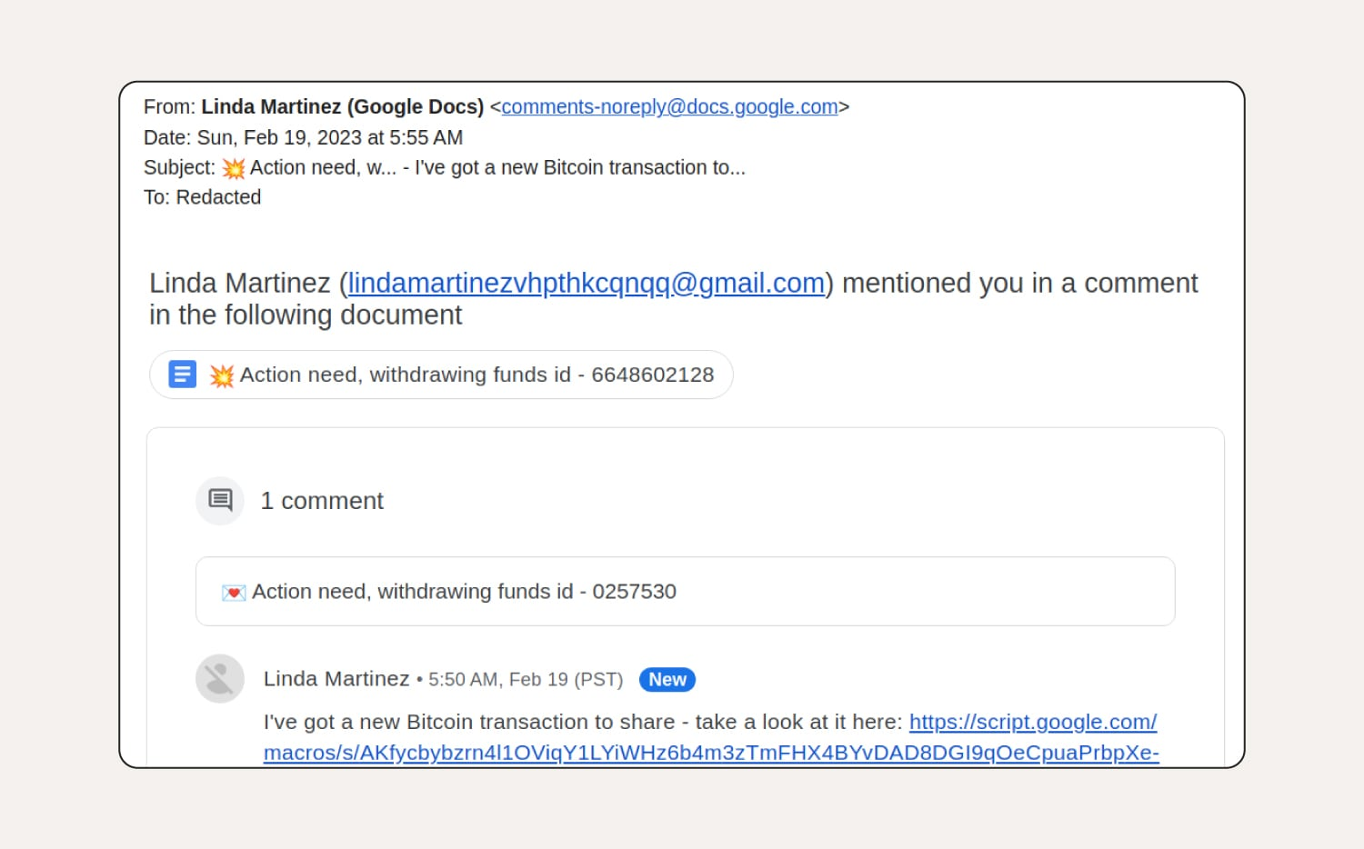
EXAMPLES OF PHISHING ATTACKS

Slide 10
Ways To Protect Yourself From Phishing Attacks
Mandatory Security Training
Avoid Information Oversharing
Use Antivirus and keep it Updated
Explain Real-Time Scenarios
Involves Executives
Identifying Phishing Emails

Slide 11
CONCLUSION
Phishing attacks are a significant cybersecurity threat that relies on deception to exploit human vulnerabilities. Understanding the different types of phishing attacks and implementing awareness training are critical steps to protect individuals and organizations. By staying informed, practicing caution, and adopting robust security measures, it is possible to reduce the risk of falling victim to these attacks and safeguard sensitive information effectively.

Slide 12
THANK YOU

